Slide 1
Design Patterns

Slide 2
Gangs of Four (GOF)
In 1994, four authors Erich Gamma, Richard Helm, Ralph Johnson and John Vlissides published a book titled Design Patterns - Elements of Reusable Object-Oriented Software.
These authors are collectively known as Gang of Four (GOF)
According to these authors design patterns are primarily based on the following principles of object orientated design
Program to an interface not an implementation
Favor object composition over inheritance

Slide 3
Design Patterns
Design Pattern
A description of a problem and its solution that you can apply to many similar programming situations
Patterns:
facilitate reuse of good, tried-and-tested solutions
capture the structure and interaction between components
Object-oriented design patterns typically show relationships and interactions between classes or objects, without specifying the final application classes or objects that are involved

Slide 4
Why is this important?
Using proven, effective design patterns can make you a better software designer & coder
You will recognize commonly used patterns in others’ code
Java API
Project team members
Ex-employees
And you'll learn when to apply them to your own code
experience reuse (as opposed to code reuse)
we want you thinking at the pattern level
In addition, different technologies have their own patterns:
Servlet patterns, GUI patterns, etc …

Slide 5
Common Design Patterns
Creational
Structural
Behavioral
Factory
Singleton
Builder
Prototype
Decorator
Adapter
Facade
Flyweight
Component architecture
Strategy
Template
Observer
Command
Iterator
State
Textbook: Head First Design Patterns

Slide 6
Creational Design Pattern
Creational design patterns provide a way to create objects while hiding the creation logic, rather than instantiating objects directly using new operator.
This gives program more flexibility in deciding which objects need to be created for a given use case.

Slide 7
The Factory Pattern
Factories make stuff
Factory classes make objects
Shouldn't constructors do that?
factory classes employ constructors
What's the point?
prevent misuse/improper construction
hides construction
provide API convenience
one stop shop for getting an object of a family type

Slide 8
What objects do factories make?
Typically objects of the same family
common ancestor
same apparent type
different actual type
Factory Pattern in the Java API:
BorderFactory.createXXXBorder methods
return apparent type of Border
return actual types of BevelBorder, EtchedBorder, etc …
lots of factory classes in security packages

Slide 9
Factory Pattern Bonus
The programmer using the Factory class never needs to know about the actual class/type
simplifies use for programmer
fewer classes to learn
Ex: Using BorderFactory, one only needs to know Border & BorderFactory
not TitledBorder, BeveledBorder, EtchedBorder, etc.

Slide 10
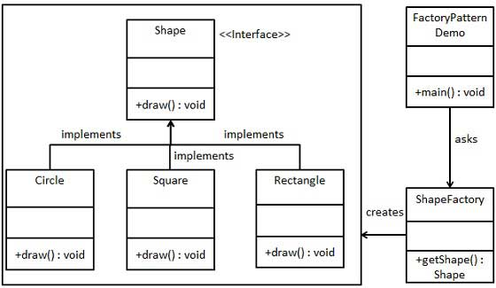
Factory Pattern Example
https://www.tutorialspoint.com/design_pattern/factory_pattern.htm

Slide 11
The Singleton Pattern
Define a type where only one object of that type may be constructed:
make the constructor private.
singleton object favorable to fully static class, why?
can be used as a method argument
class can be extended
What makes a good singleton candidate?
central app organizer class
something everybody needs

Slide 12
Example: The PropertiesManager Singleton
public class PropertiesManager
{
private static PropertiesManager singleton
= null;
private PropertiesManager() {}
public static PropertiesManager
getPropertiesManager()
{
if (singleton == null)
{ singleton = new PropertiesManager();
}
return singleton;
}
…
}

Slide 13
What's so great about a singleton?
Other classes may now easily USE the PropertiesManager
PropertiesManager singleton =
PropertiesManager.getPropertiesManager();
Singleton.dowhaterver()
Don’t have to worry about passing objects around
Don’t have to worry about object consistency
Note: the singleton is of course only good for classes that will never need more than one instance in an application
https://www.tutorialspoint.com/design_pattern/singleton_pattern.htm

Slide 14
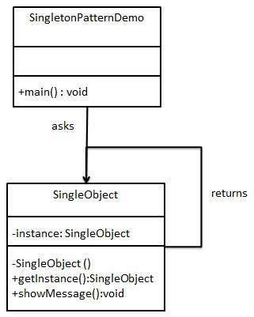
Singleton Pattern Example
https://www.tutorialspoint.com/design_pattern/singleton_pattern.htm

Slide 15
The Builder Pattern
Use the Builder Pattern to:
encapsulate the construction of a product
allow it to be constructed in steps
Good for complex object construction
objects that require lots of custom initialized pieces
Scenario:
build a JavaFX component
put it in its container
register it by id to be retrieved later
add a style class
etc.

Slide 16
The Builder Pattern
public class AppNodesBuilder {
public CheckBox buildCheckBox(
public ColorPicker buildColorPicker(
public ComboBox buildComboBox(
public HBox buildHBox(
public Label buildLabel(
public Slider buildSlider(
public VBox buildVBox(
public Button buildIconButton(
public Button buildTextButton(
public ToggleButton buildIconToggleButton(
public ToggleButton buildTextToggleButton(
public TextField buildTextField(
public TableView buildTableView(
public TableColumn buildTableColumn(
…
}

Slide 17
Using a builder
// INIT CONTROLS
HBox nameOwnerPane = tdlBuilder.buildHBox(…
HBox namePane = tdlBuilder.buildHBox(…
Label nameLabel = tdlBuilder.buildLabel(…
TextField nameTextField = tdlBuilder.buildTextField(…
HBox ownerPane = tdlBuilder.buildHBox(…
Label ownerLabel = tdlBuilder.buildLabel(…
TextField ownerTextField = tdlBuilder.buildTextField(…

Slide 18
Builder Benefits
Encapsulates the way a complex object is constructed.
Allows objects to be constructed in a multistep and varying process (as opposed to one step factories).
Hides the internal representation of the product from the client.
Product implementations can be swapped in and out because the client only sees an abstract interface.

Slide 19
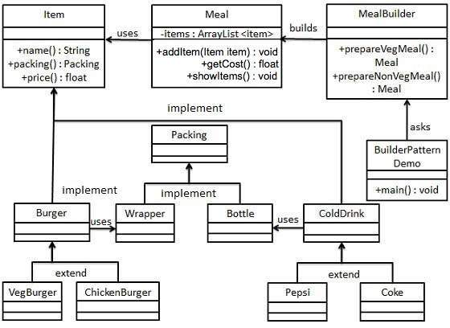
Builder Pattern Example
https://www.tutorialspoint.com/design_pattern/builder_pattern.htm

Slide 20
The Prototype Pattern
Use the Prototype Pattern when creating an instance of a given class is either expensive or complicated.
This pattern involves implementing a prototype interface which tells to create a clone of the current object.
This pattern is used when creation of object directly is costly.
For example, an object is to be created after a costly database operation.
We can cache the object, returns its clone on next request and update the database as and when needed thus reducing database calls.

Slide 21
So what does the Prototype Pattern do?
Allows you to make new instances by copying existing instances
in Java this typically means using the clone() method, or de-serialization when you need deep copies
A key aspect of this pattern is that the client code can make new instances without knowing which specific class is being instantiated

Slide 22
Prototype Benefits
Hides the complexities of making new instances from the client.
Provides the option for the client to generate objects whose type is not known.
In some circumstances, copying an object can be more efficient than creating a new object.

Slide 23
Prototype Uses and Drawbacks
Prototype should be considered when a system must create new objects of many types in a complex class hierarchy.
A drawback to using the Prototype is that making a copy of an object can sometimes be complicated.

Slide 24
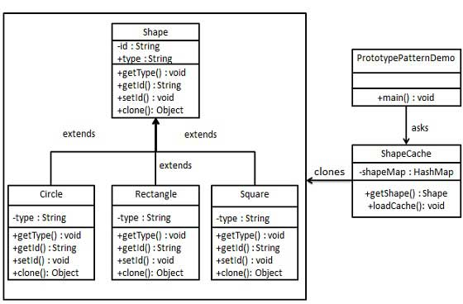
A Prototype Pattern Example
https://www.tutorialspoint.com/design_pattern/prototype_pattern.htm

Slide 25
Structural Design Patterns
These design patterns concern class and object composition.
Concept of inheritance is used to compose interfaces and define ways to compose objects to obtain new functionalities.

Slide 26
The Decorator Pattern
Attaches additional responsibilities to an object dynamically.
i.e. decorating an object
Decorators provide a flexible alternative to sub-classing for extending functionality
How?
By wrapping an object
Works on the principle that classes should be open to extension but closed to modification
Allow classes to be easily extended to incorporate new behavior without modifying existing code

Slide 27
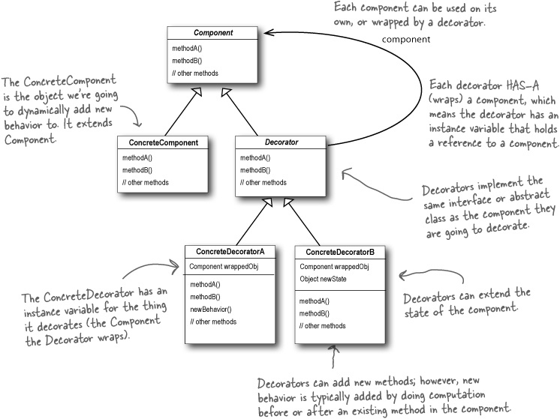
Decorators Override Functionality

Slide 28
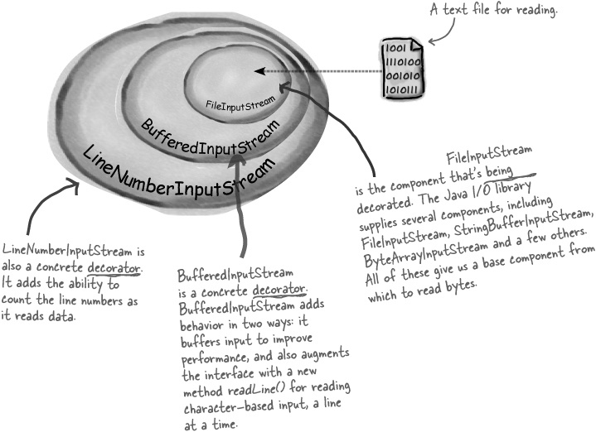
Java’s IO Library

Slide 29
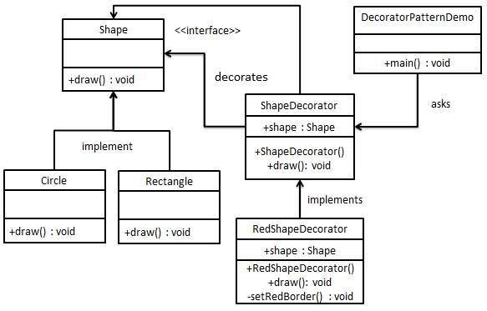
Decorator Pattern Example
https://www.tutorialspoint.com/design_pattern/decorator_pattern.htm

Slide 30
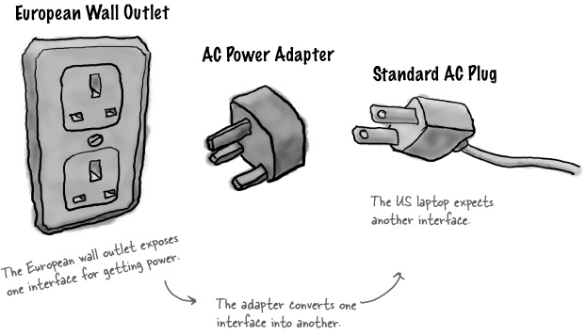
Ever been to Europe?
This is an abstraction of the Adapter Pattern

Slide 31

The Adapter Pattern
Converts the interface of a class into another interface a client expects
Adapter lets classes work together that couldn’t otherwise because of incompatible interfaces
Interfaces?
Do you know what a driver is?

Slide 32
Adapter Scenario
You have an existing system
You need to work a vendor library into the system
The new vendor interface is different from the last vendor
You really don’t want to change your existing system
Solution?
Make a class that adapts the new vendor interface into what the system uses

Slide 33
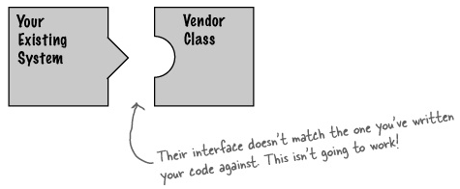
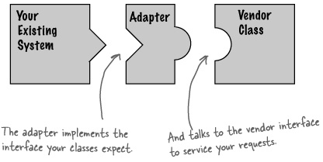
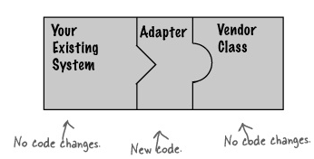
Adapter Visualized

Slide 34
How do we do it?
Ex: Driver
Existing system uses a driver via an interface
New hardware uses a different interface
Adapter can adapt differences
Existing system HAS-A OldInterface
Adapter implements OldInterface and HAS-A NewInterface
Existing system calls OldInterface methods on adapter, adapter forwards them to NewInterface implementations

Slide 35
What’s good about this?
Decouple the client from the implemented interface
If we expect the interface to change over time, the adapter encapsulates that change so that the client doesn’t have to be modified each time it needs to operate against a different interface.

Slide 36
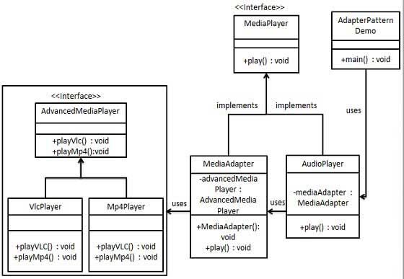
Adapter Pattern Example
https://www.tutorialspoint.com/design_pattern/adapter_pattern.htm

Slide 37
The Facade Pattern
Provides a unified interface to a set of interfaces in a subsystem.
The facade defines a higher-level interface that makes the subsystem easier to use
Employs the principle of least knowledge
A facade is a class or a group of classes hiding internal implementation/services from the user.
The factory pattern is used when you want to hide the details on constructing instances.

Slide 38
Scenario: We need a dialog
Making a dialog can be a pain
setting up controls
providing layout
many common simple dialogs needed
applications like common presentation settings
Solution?
AppDialogsFacade

Slide 39
AppDialogsFacade
public class AppDialogsFacade {
public static void showAboutDialog(
public static void showExportDialog(
public static void showHelpDialog(
public static void showLanguageDialog(
public static void showMessageDialog(
public static File showOpenDialog(
public static File showSaveDialog(
public static void showStackTraceDialog(
public static String showTextInputDialog(
public static String showWelcomeDialog(
public static ButtonType showYesNoCancelDialog(
}

Slide 40
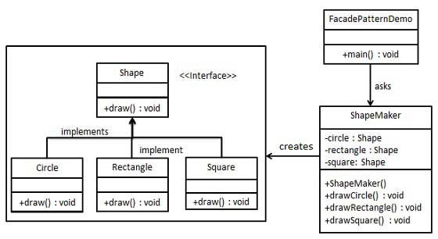
Tutorial
https://www.tutorialspoint.com/design_pattern/facade_pattern.htm

Slide 41
Which is which?
Converts one interface to another
Makes an interface simpler
Doesn’t alter the interface, but adds responsibility
Decorator
Adapter
Facade

Slide 42
The Flyweight Pattern
A “neat hack”
Allows one object to be used to represent many identical instances
Flyweights must be immutable.
Flyweights depend on an associated table
maps identical instances to the single object that represents all of them
Used in processing many large documents
search engines
a document as an array of immutable Strings
repeated Words would share objects
just one object for “the” referenced all over the place
use static Hashtable to store mappings
The flyweight pattern is used to minimize the amount of memory used when you need to create a large number of similar objects. It accomplishes this by sharing instances.
The name derives from the weight classification in boxing, but refers to the little amount of memory. That is, memory = weight.

Slide 43
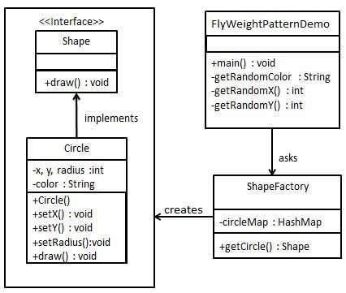
Flyweight Pattern Example
https://www.tutorialspoint.com/design_pattern/flyweight_pattern.htm

Slide 44

A Component Architecture
System uses a set of pluggable components
Each component:
can be plugged in
can be updated
can be replaced
independently of the other components
Notes:
https://www.geek.com/wp-content/uploads/2018/03/legomain-625x352.png

Slide 45
AppTemplate uses Components
With Default behavior:
AppFileModule
AppFoolproofModule
AppGUIModule
AppLanguageModule
AppRecentWorkModule
With Custom behavior:
AppClipboardComponent
AppDataComponent
AppFileComponent
AppWorkspaceComponent

Slide 46
Behavioral Design Pattern
These design patterns are specifically concerned with communication between objects.
Increase flexibility in carrying out communication between objects.
https://www.youtube.com/watch?v=kiTDR0YoIqA

Slide 47
The Strategy Pattern
How does it work?
defines a family of algorithms, encapsulates each one, and makes them interchangeable
lets the algorithm vary independently from the clients that use them
A class behavior or its algorithm can be changed at run time.
In Strategy pattern, we create objects which represent various strategies and a context object whose behavior varies as per its strategy object.
The strategy object changes the executing algorithm of the context object.
Classes can be composed (HAS-A) of the interface type
the interface type is the apparent type
the actual type can be determined at run-time

Slide 48
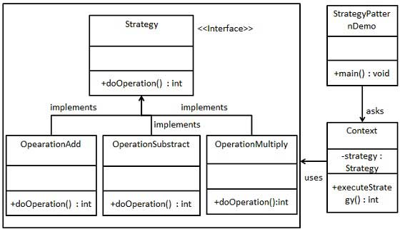
Strategy Pattern Example
https://www.youtube.com/watch?v=QKeL46JoDU4
https://www.tutorialspoint.com/design_pattern/strategy_pattern.htm

Slide 49
Template Method Pattern
Defines the skeleton of an algorithm in a method, deferring some steps to subclasses.
Lets subclasses redefine certain steps of an algorithm without changing the algorithm’s structure.
A template for an algorithm
https://www.youtube.com/watch?v=bPVDEkl1z0o

Slide 50
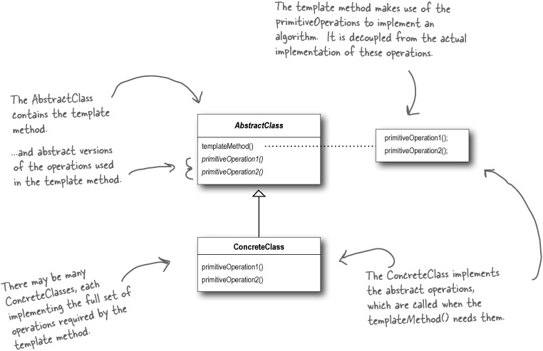
Template Method Pattern

Slide 51
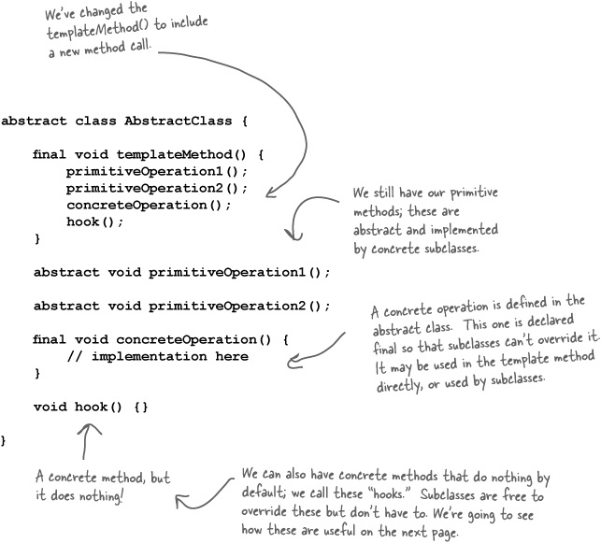
Template Method Pattern

Slide 52
What’s a hook?
A type of method
Declared in the abstract class
only given an empty or default implementation
Gives subclasses the ability to “hook into” the algorithm at various points, if they wish
a subclass is also free to ignore the hook.

Slide 53
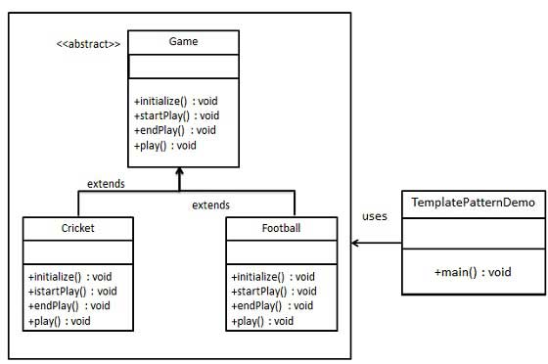
Template Design Pattern Example

Slide 54
The Observer Pattern
Defines a one-to-many dependency between objects so that when one object changes state, all of its dependents are notified and updated automatically.
Hmm, where have we seen this?
in our GUI
State Manager class maintains application's state
call methods to change app's state
app's state change forces update of GUI

Slide 55
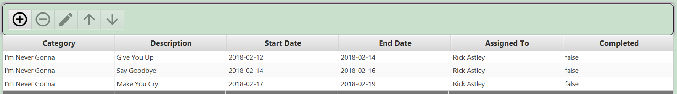
TableView
Used to display spreadsheets and tables
How is the table data stored?
in an ObservableList
we call this the table’s data model

Slide 56
Editing the table
To edit the table, you must go through the model:
TableView table = new TableView(…
ObservableList<DataPrototype> model = table.getItems();
// Add Data
model.add(…
// Remove Data
model.remove(…
// Change Data
DataPrototype data = model.get(…
data.set(…
// UPDATING THE MODEL (ObservableList) AND/OR THE DATA (DataPrototype)
// WILL AUTOMATICALLY UPDATE THE VIEW (TableView) THANKS TO MVC!

Slide 57
Complex Controls have their own States
Tables, trees, lists, combo boxes, etc.
data is managed separately from the view
when state changes, view is updated
This is called MVC
Model
View
Controller
MVC employs the Observer Pattern

Slide 58
MVC employs the Observer Pattern
Model
data structure, no visual representation
notifies views when something interesting happens
View
visual representation
views attach themselves to model in order to be notified
Controller
event handler
listeners that are attached to view in order to be notified of user interaction (or otherwise)
MVC Interaction
controller updates model
model tells view that data has changed
view redrawn

Slide 59
Controller
Model
View
update (add, etc.)
notify
repaint
return
return

Slide 60
MVC Architecture
The model passes its data to the view for rendering
Model
View
The view determines which events are passed to the controller
The controller updates the model based on events received
Controller

Slide 61
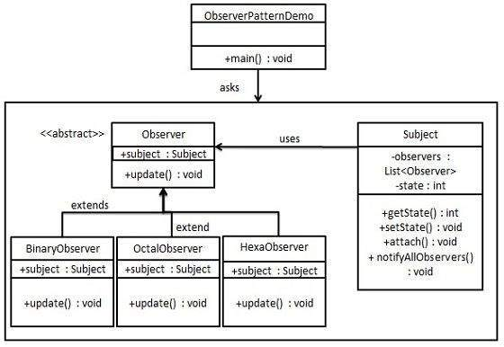
Observer Design Pattern Example
https://www.tutorialspoint.com/design_pattern/observer_pattern.htm

Slide 62
Command Abstraction
For many GUIs, a single function may be triggered by many means (e.g., keystroke, menu, button, etc…)
we want to link all similar events to the same listener
The information concerning the command can be abstracted to a separate command object
Common Approach:
specify a String for each command
have listener respond to each command differently
ensure commands are handled in a uniform way
commands can be specified inside a text file
The Command Pattern
https://www.youtube.com/watch?v=iNKvqMiPtmY

Slide 63
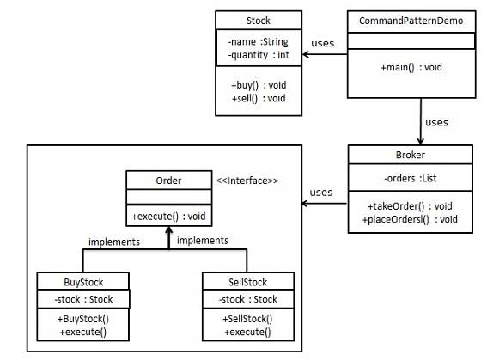
Command Design Pattern Example
https://www.tutorialspoint.com/design_pattern/command_pattern.htm

Slide 64
Iteration
What’s the problem?
you have to perform some operation on a sequence of elements in a given data structure
Solution:
Iterator Pattern a.k.a. Iteration Abstraction
iterate over a group of objects without revealing details of how the items are obtained
https://www.youtube.com/watch?v=Pganyj1dVVU

Slide 65
Iterator
An Iterator produces proper elements for processing
Defining an Iterator may be complex
Using an Iterator must be simple
they’re all used in the same way
E.g. update() all elements of List list:
Iterator it;
for (it=list.listIterator(); it.hasNext(); )
it.next().update();
Makes iteration through elements of a set “higher level”
Separates the production of elements for iteration from the operation at each step in the iteration.

Slide 66
Iterator (cont’d)
Iterator is a design pattern that is encountered very often.
Problem: Mechanism to operate on every element of a set.
Context: The set is represented in some data structure (list, array, hashtable, etc.)
Solution: Provide a way to iterate through every element.
Common Classes using Iterators in Java API
StringTokenizer
Vector, ArrayList, etc …
Even I/O streams work like Iterators

Slide 67
Iterator (in Java)
public interface Iterator {
// Returns true if there are more
// elements to iterate over; false
// otherwise
public boolean hasNext();
// If there are more elements to
// iterate over, returns the next one.
// Modifies the state “this” to record
// that it has returned the element.
// If no elements remain, throw
// NoSuchElementException.
public Object next()
throws NoSuchElementException;
public void remove();
}

Slide 68
Iterator vs. Enumeration
Java provides another interface Enumeration for iterating over a collection.
Iterator is
newer (since JDK 1.2)
has shorter method names
has a remove() method to remove elements from a collection during iteration
Iterator Enumeration
hasNext() hasMoreElements()
next() nextElement()
remove() -
Iterator is recommended for new implementations.

Slide 69
Example Loop controlled by next()
private Payroll payroll = new Payroll();
...
public void decreasePayroll() {
Iterator it = payroll.getIterator();
while (it.hasNext()) {
Employee e = (Employee)it.next();
double salary = e.getSalary();
e.setSalary(salary*.9);
}
for (Employee emp : payroll) {
}
}

Slide 70
Implementing an Iterator
public class Payroll {
private Employee[] employees;
private int num_employees;
...
// An iterator to loop through all Employees
public Iterator getIterator() {
return new EmplGen();
}
...
private class EmplGen implements Iterator {
// see next slide
...
}
}

Slide 71
Implementing an Iterator
private class EmplGen implements Iterator {
private int n = 0;
public boolean hasNext() {
return n < num_employees;
}
public Object next() throws NoSuchElementException {
Object obj;
if (n < num_employees) {
obj = employees[n];
n++;
return obj;
}
else throw new NoSuchElementException
("No More Employees");
}
}
state of iteration
captured by index n
returns true if there
is an element left
to iterate over
returns the next
element in the
iteration sequence

Slide 72
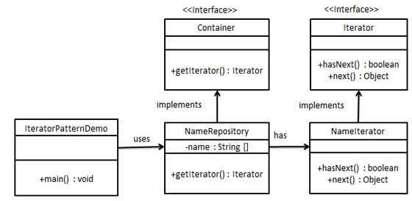
Iterator Design Pattern Example
https://www.tutorialspoint.com/design_pattern/iterator_pattern.htm

Slide 73
State Pattern
Dynamically change the representation of an object.
also called Data Abstraction
Users of the object are unaware of the change.
Example:
Implement a set as a Vector if the number of elements is small
Implement a set as a Hashtable if the number of elements is large
State pattern is used only on mutable objects.

Slide 74
Example: Set
public class Set {
private Object elements;
public boolean isIn(Object member){
if (elements instanceof Vector)
// search using Vector methods
else
// search using Hashtable methods
}
public void add(Object member){
if (elements instanceof Vector)
// add using Vector methods
else
// add using Hashtable methods
}
}

Slide 75
Using the state pattern: SetRep
public interface SetRep {
public void add(object member);
public boolean isIn(Object member);
public int size();
public void remove();
}
public class SmallSet implements SetRep {
private Vector set;
public void add(Object element) { ... }
public void remove() { ... }
...
}
public class LargeSet implements SetRep {
private Hashtable set;
public void add(Object element) { ... }
public void remove() { ... }
...
}

Slide 76
Using the state pattern: a new Set
public class Set {
private SetRep rep;
private int threshold;
public void add(Object element) {
if (rep.size() == threshold)
rep = new LargeSet(rep.elements());
rep.add(element);
}
public void remove(Object element) {
rep.remove(elem);
if (rep.size == threshold)
rep = new SmallSet(rep.elements());
}
}

Slide 77
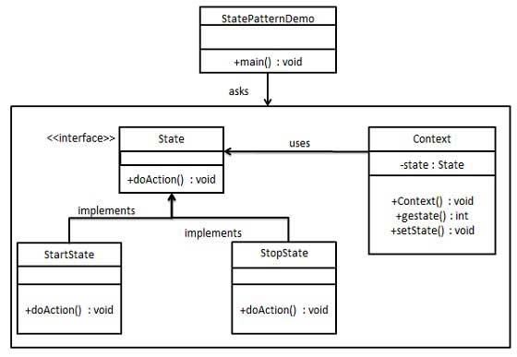
State Pattern Example
https://www.tutorialspoint.com/design_pattern/state_pattern.htm

Slide 78
There are others too
Chain of Responsibility
Composite
Interpreter
Mediator
Memento
Proxy
Visitor

